Slide 1
SmartPlant 3D Drawings Configuration
Global Services

Slide 2
SmartSketch Basics
Symbol Browser (2D)
Move sheet border (2D)
Import Option fit to sheet (2D)

Slide 3
Drawing Templates
Border Template
Drawing Area (2D)
Border Labels (2D)
Layout Template
Region (2D)
Views Layout (2D)

Slide 4
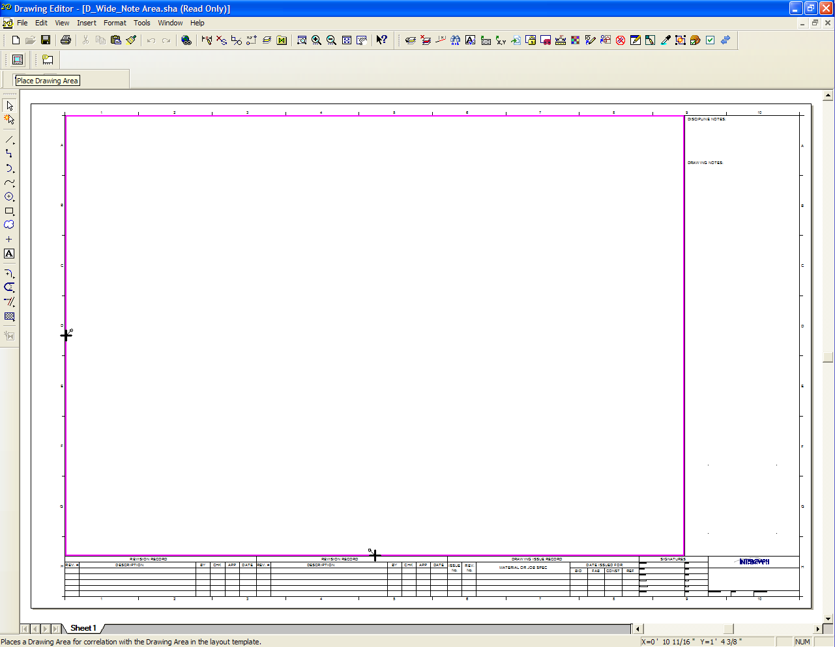
Drawing Area
The border template contains the drawing area, used in conjunction with layout templates

Slide 5
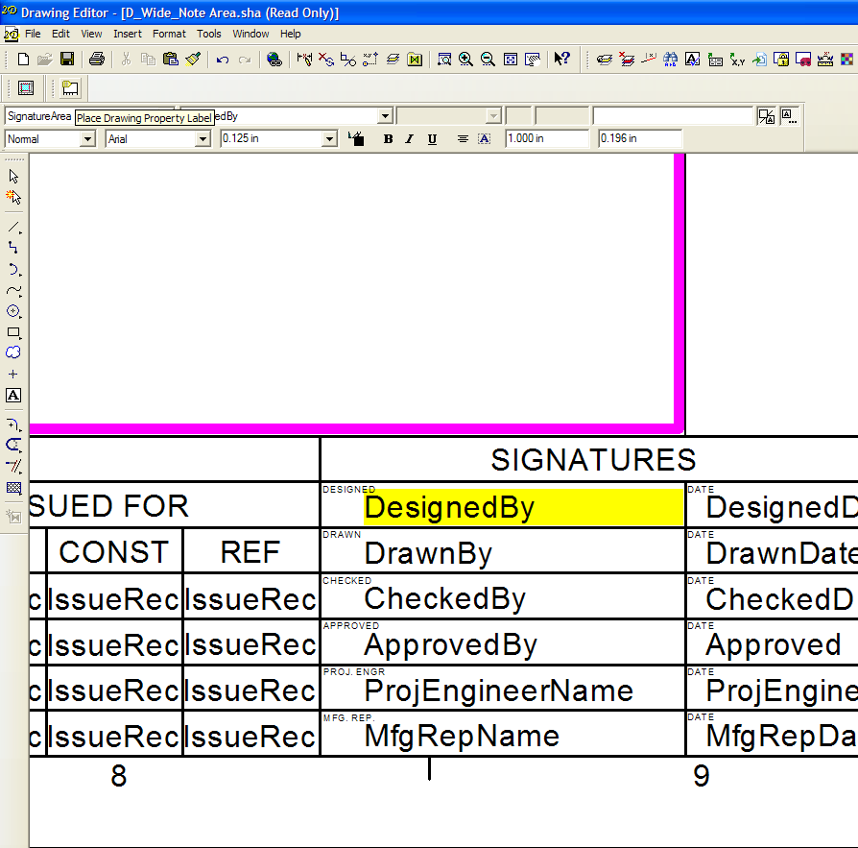
Border Labels
The border template also contains drawing property labels for the title block

Slide 6
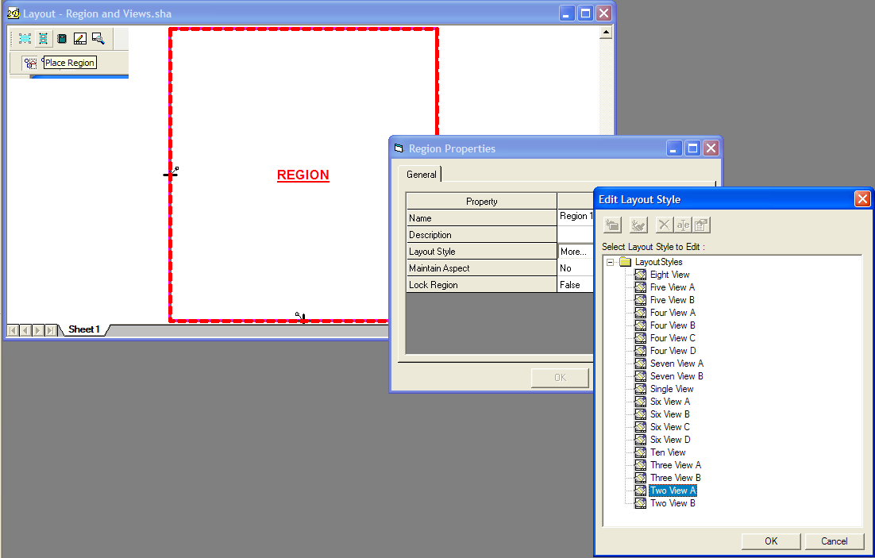
Region
A region has a layout style that dictates view number and position

Slide 7
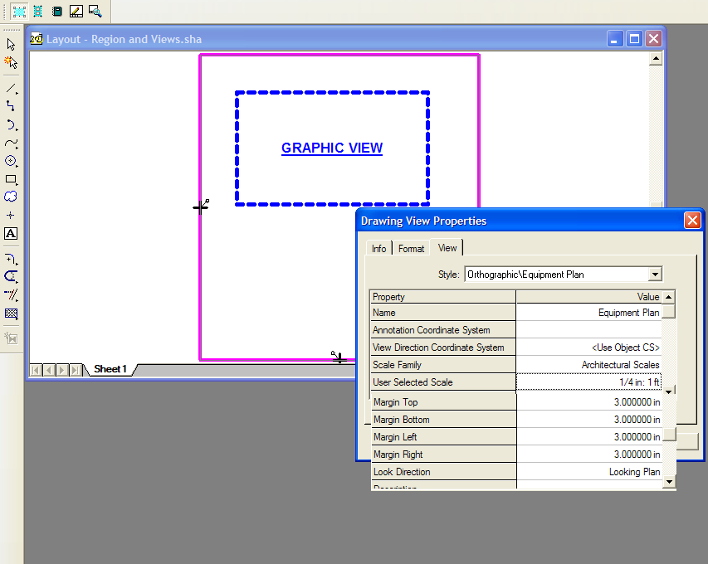
Views
The view properties set the scale, look direction and margins

Slide 8
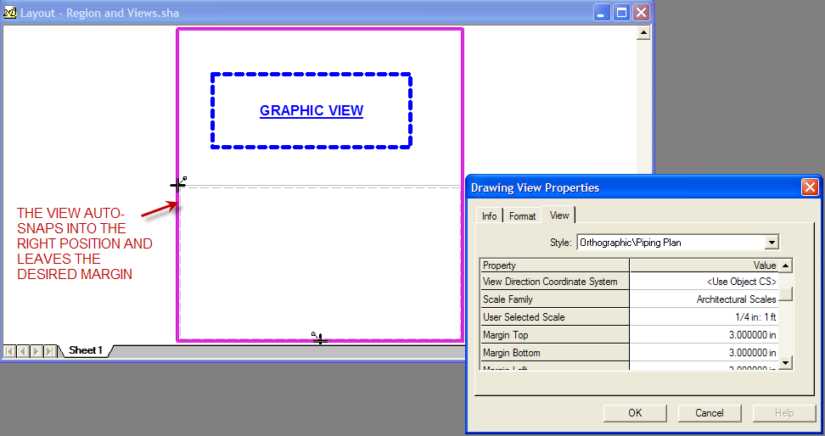
View Positioning

Slide 9
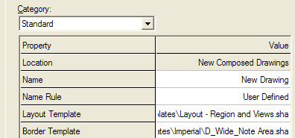
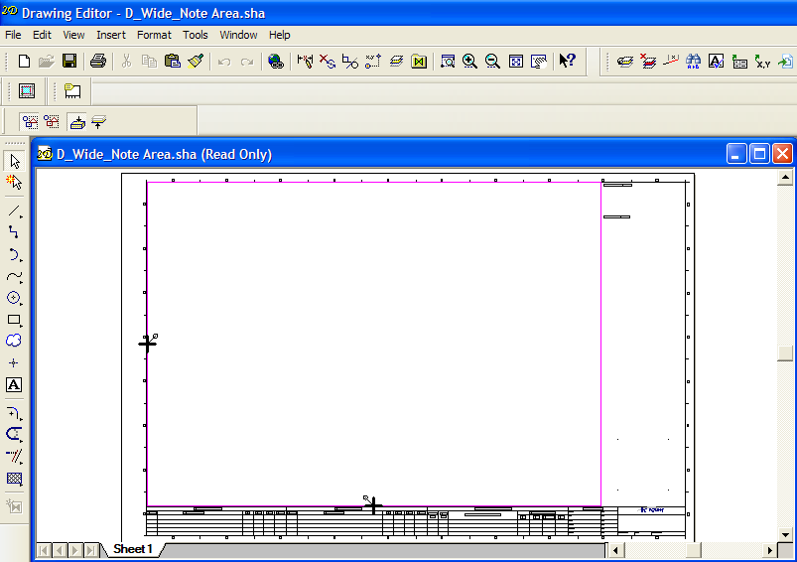
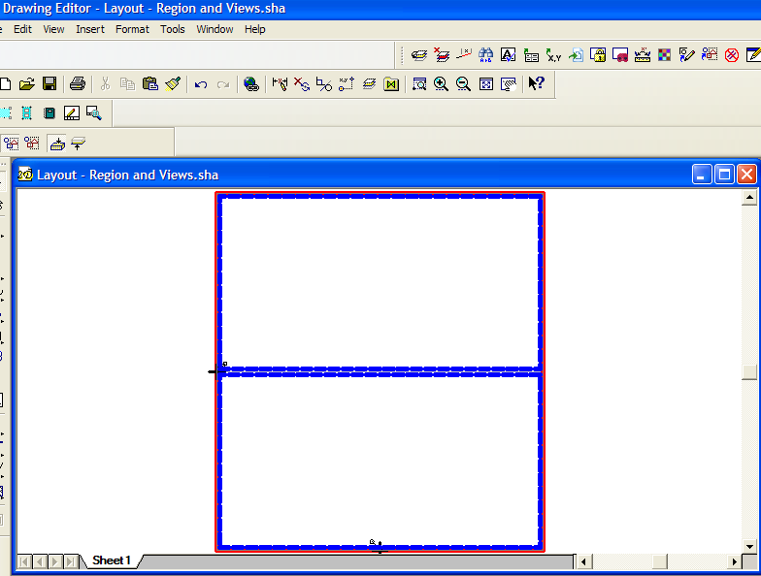
New Drawing
Combines border template and layout template

Slide 10
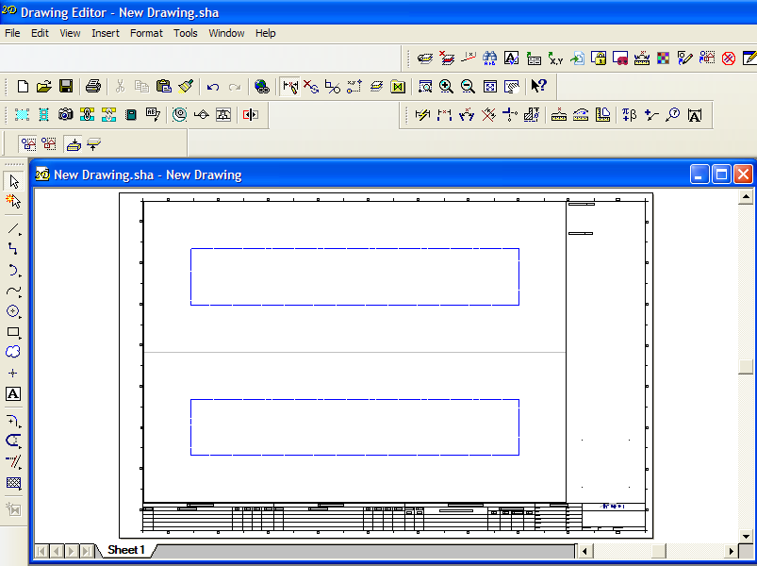
New Drawing
“Fits” the drawing area from layout template into drawing area in border template

Slide 11
Lab 1 and 2

Slide 12
Analysis of drawings for view style creation
Contents – Object Type and Classification
Graphics – Line style, thickness, color
Label – Data, Position and Graphics
Dimensions – Units, Position and Type
Miscellaneous - View Labels, North Arrows, Matchlines
Title Blocks and Border Graphics

Slide 13
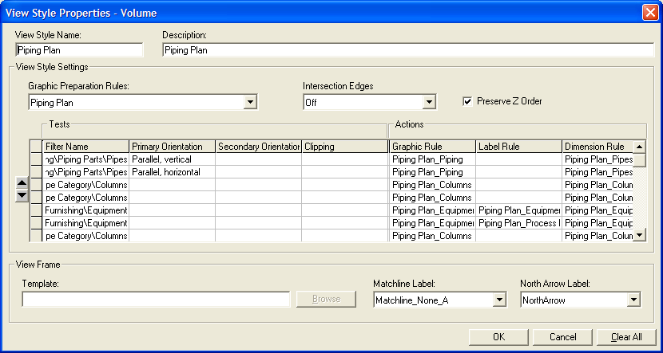
Example – Piping Plan

Slide 14
Example Output – Piping Plan
Pipe Labels
Equipment Labels
Structure as reference style
Grid Labels
Matchlines
Key Plan
North Arrow
Dimensions

Slide 15
View Styles
Filter Behavior - Volume/Snapshot
Intersection Edges - needed for fill style
Preserve Z Order
View Rules
North Arrows Rules
Matchline Rules

Slide 16
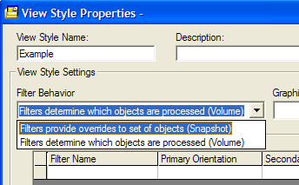
Filter Behavior
Volume/Snapshot
Volume means everything that’s in the volume that meets the style is on drawing
Snapshot means everything that’s in the volume is on drawing

Slide 17
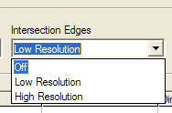
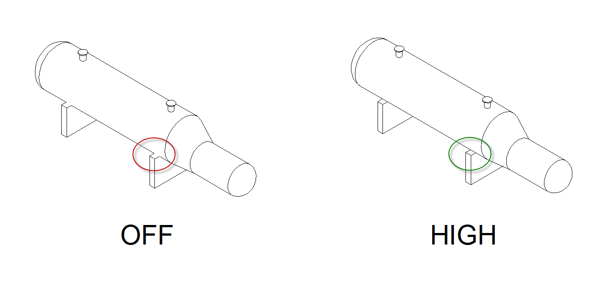
Intersection Edges
Edges Off for GA drawings
Edges Low for less detail
Edges High for hanger or equipment drawings or where a fill style is to be used

Slide 18
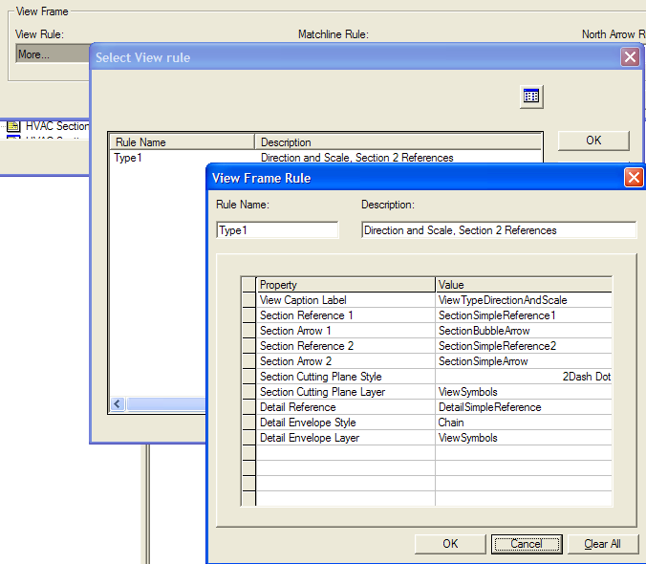
View Rules
Used to auto-label and set styles for section and details views that are placed on the parent view

Slide 19
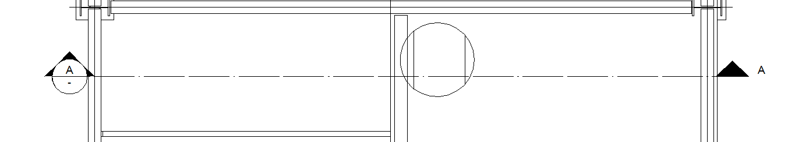
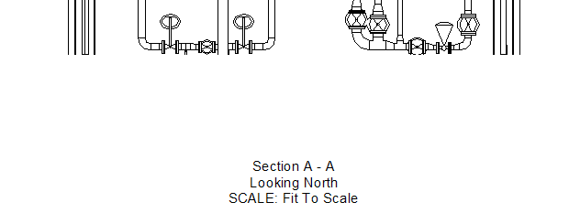
View Rules Output
The cutting plane line style, the section bubble format as well as the labeling for the section view itself are controlled by the view rules

Slide 20
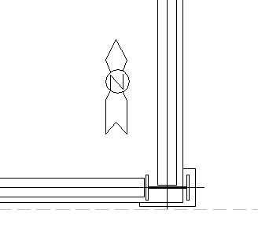
North Arrows Rules
Allows you to position a north arrow in plan and elevation/section views

Slide 21
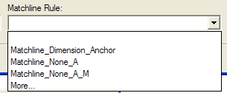
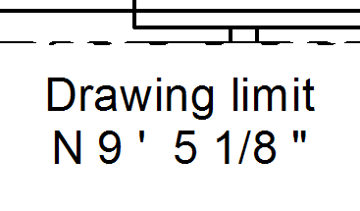
Matchline Rules
Allows you to label the coordinates of the matchline and the name of the neighbouring drawing
The dimension anchor rule will add the matchline to the set of objects that gets dimensioned

Slide 22
View Style Rows
Tests
Filter
Orientation
Clipping
Actions
Graphic Rule
Label Rule
Dimension Rule

Slide 23
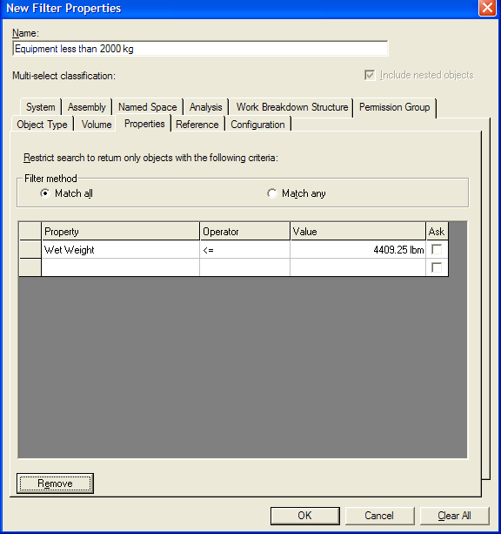
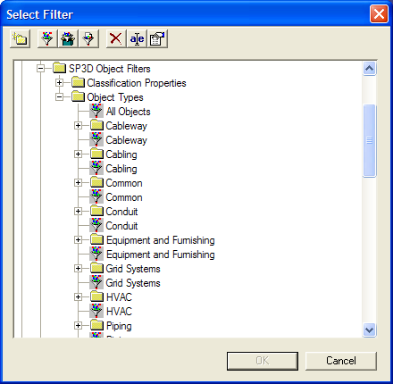
Filters
Many catalog filters delivered
We deliver filters for all object types.
Filter by properties
(=, <, >, <=, >=, Contains, etc…)

Slide 24
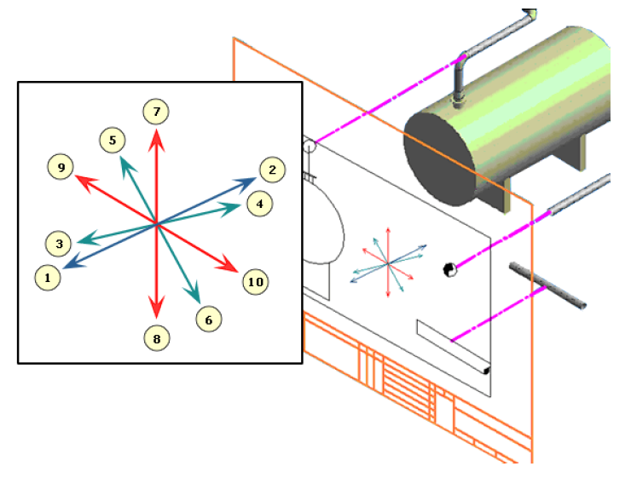
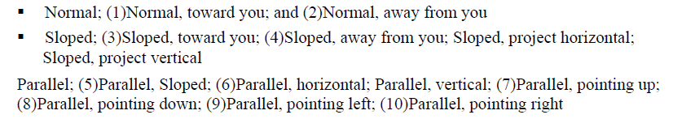
Orientation
Allows use of different rule application based on orientation in sheet of paper e.g. dimension horizontal pipes to other horizontal pipes

Slide 25
Clipping
Used to resymbolize clipped ends of objects
Used to label at the point of clipping, i.e. if clipped on the right, label on the right etc.

Slide 26
Graphic Rules
Visible/Hidden/Hidden by Self
Creating new line styles (2D)
Creating a new linear pattern (2D)
Layer
Visible Fill Style
Creating new fill styles (2D)
Importing Autocad patterns (2D)
Clipped Solid Fill Style
Make clipped solid monolithic

Slide 27
Graphic Rules - continued
Show Centerline
Clipping
Make Transparent

Slide 28
Graphic Rules

Slide 29
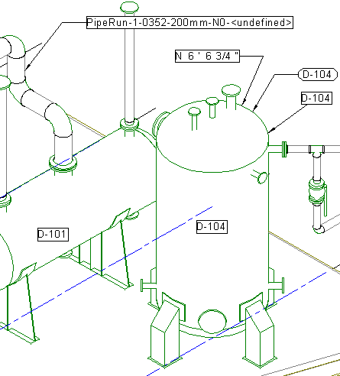
Graphic Rules - Examples

Slide 30
Graphic Rules – VHL
Visible – sets style for Visible edges of objects
Hidden – sets style for edges of objects hidden by other objects
Hidden by Self – sets style for edges of objects hidden by other surfaces of the same object
Occluded – sets style for edges of objects completed occluded by neighbouring objects

Slide 31
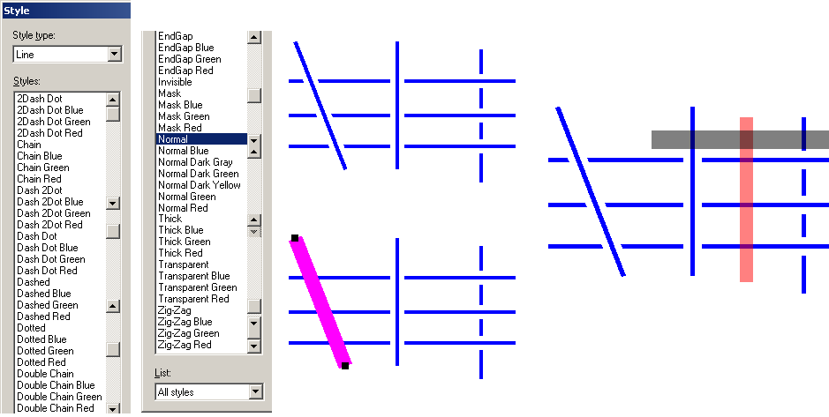
Graphic Rules – Line Styles

Slide 32
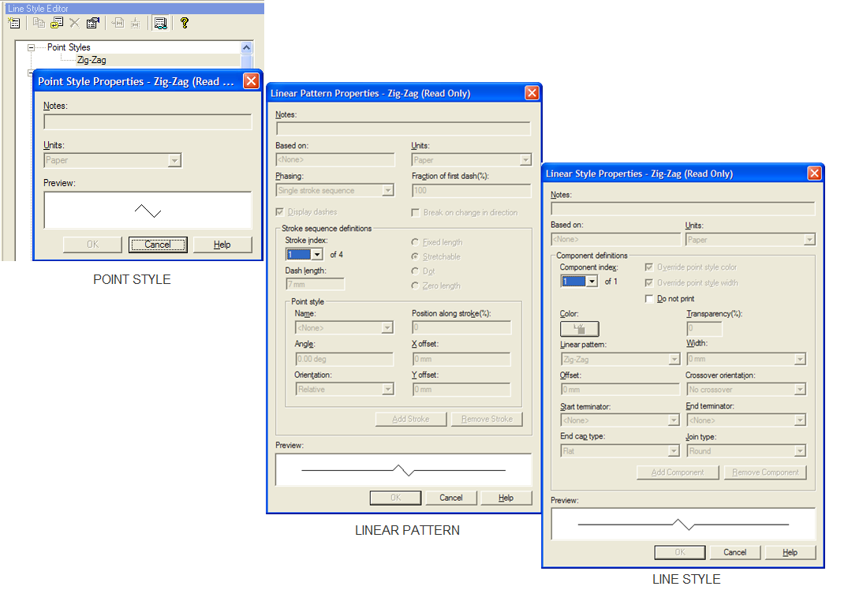
Creating new line styles (2D)

Slide 33
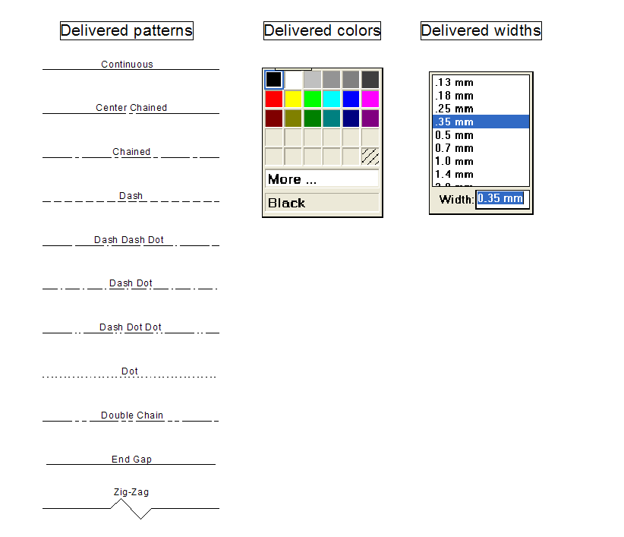
Delivered Line Styles

Slide 34
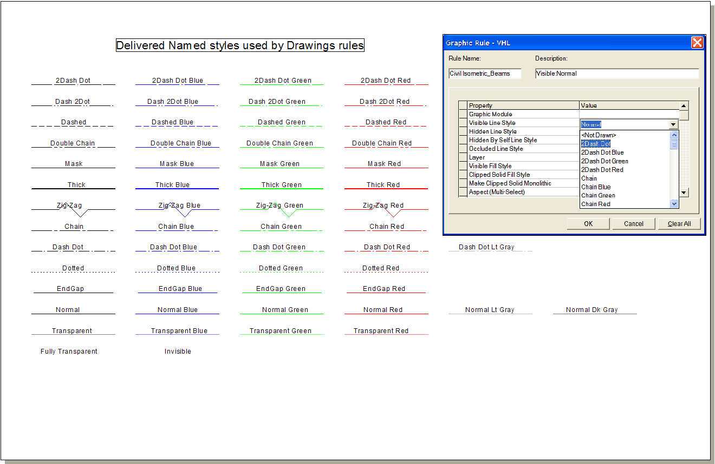
Delivered Named Styles

Slide 35
Lab 3 and 4

Slide 36
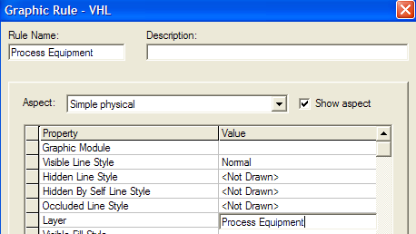
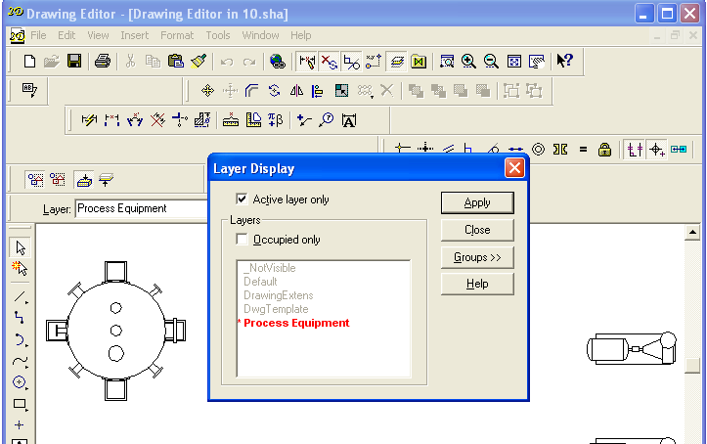
Layer
Each graphic rule allows selection of a layer and creating geometry in the layer – if the layer is not present, it is created

Slide 37
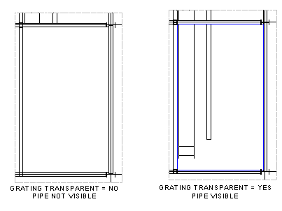
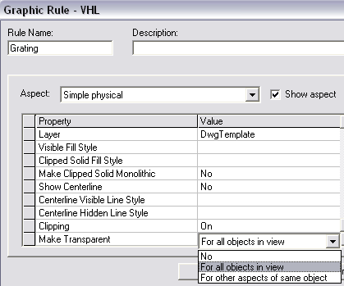
Make Transparent
Make (Grating) Transparent for all objects in view

Slide 38
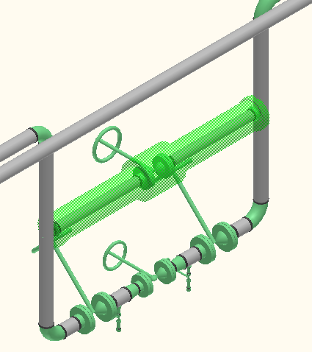
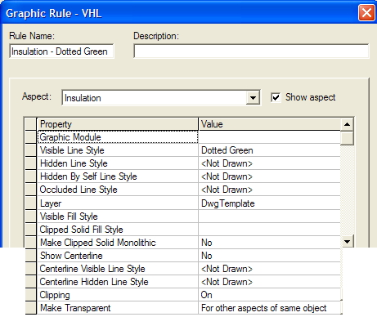
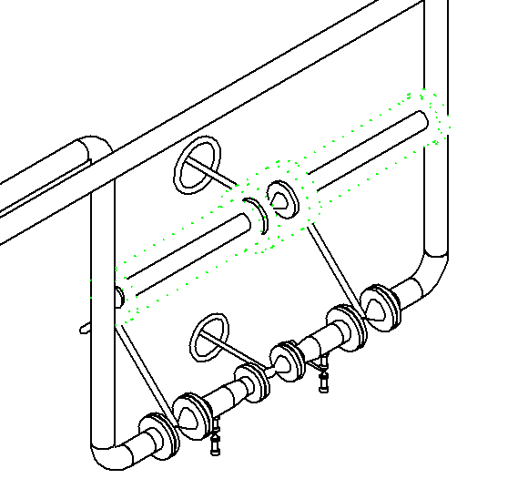
Aspects
Insulation aspect dotted green

Slide 39
Lab 5, 6 and 7

Slide 40
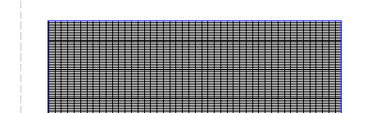
Visible Fill Style
A fill style may be used to fill in the visible portion of an object.
This is commonly used to show grating

Slide 41
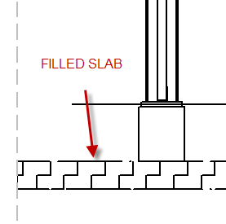
Clipped Solid Fill Style
A fill style is used to fill the portion of 3D solids which are clipped in the view
This is commonly used to indicate that material is being cut

Slide 42
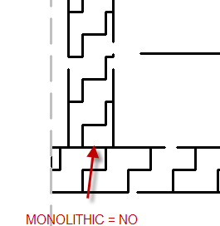
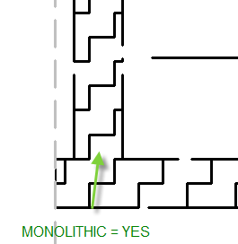
Make clipped solid monolithic
This option makes the fill for contiguous solids monolithic (removes edges of solids that would normally be shown)

Slide 43
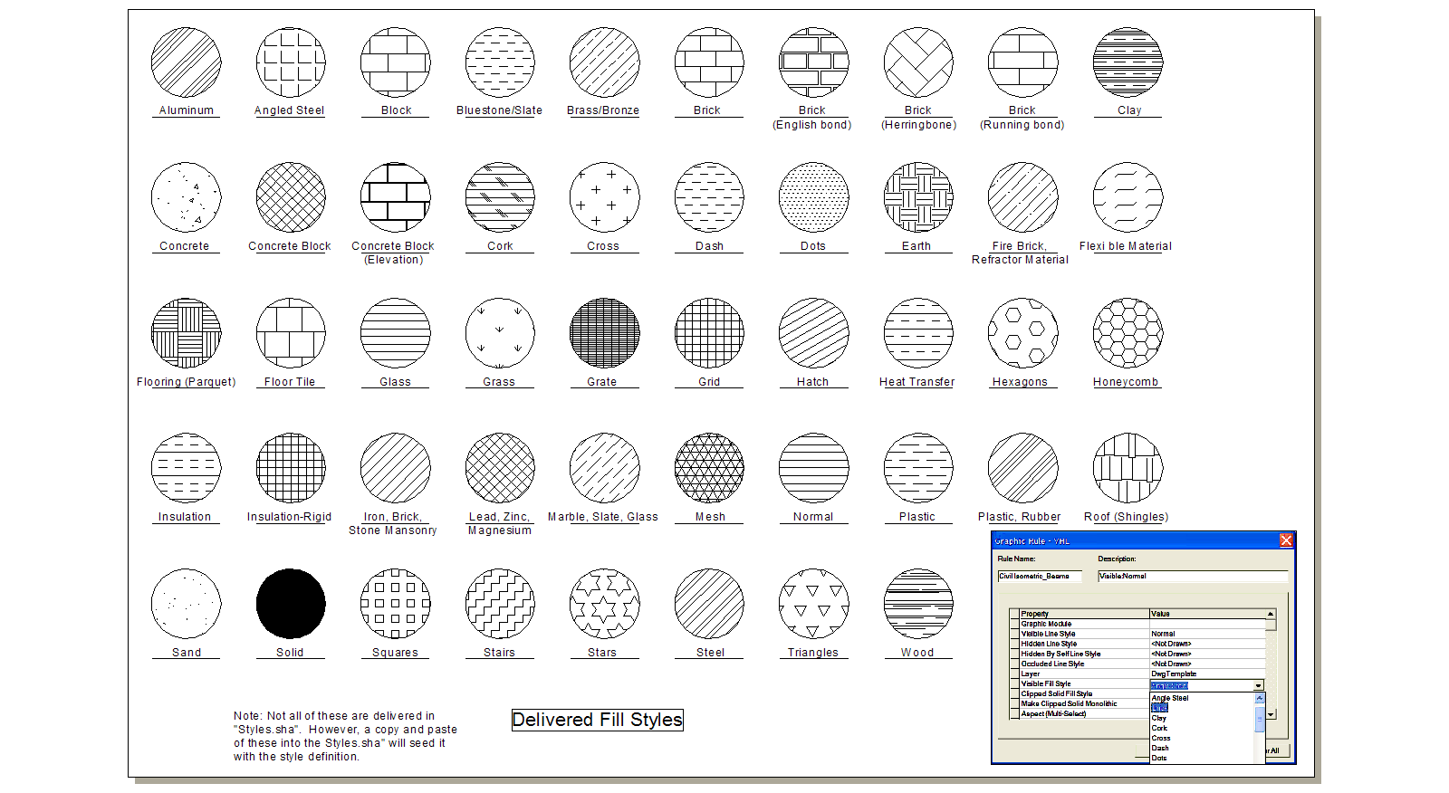
Delivered Fill Styles

Slide 44
Lab 8 and 9

Slide 45
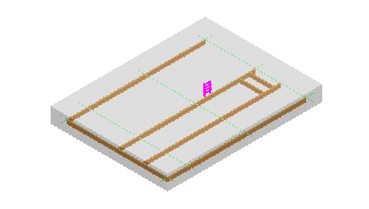
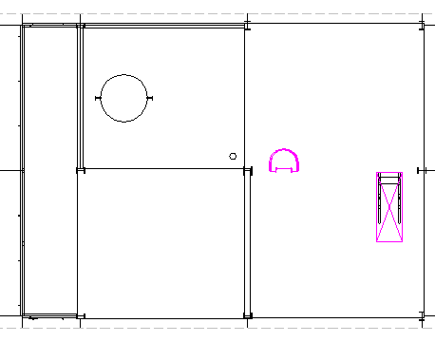
Clipping
The ladder is actually clipped in the 3D model
Setting Clipping = Off in the graphic rule treats it as if its not clipped for the drawing

Slide 46
Replace with Line
Replace with line
Replace with line and widget
Widget graphics

Slide 47
Replace with symbol
Orientation Option – Orients symbol according to 3D orientation or always fixed
Symbol Reports
Parametric symbols driven by 3D model data values (2D)

Slide 48
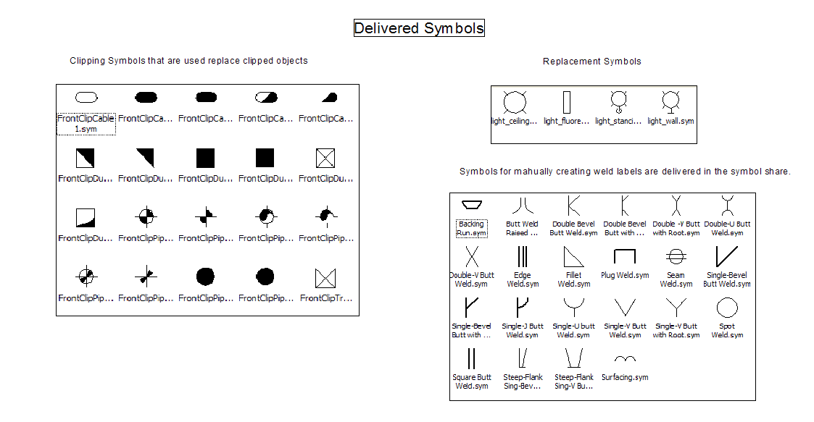
Delivered Symbols

Slide 49
Graphic Preparation Rules
Common
Piping
Equipment
Hangers
Structure
Grids

Slide 50
Common
Make Drawable
Exclude
GetActual3DGeometry
ReplaceWPoint

Slide 51
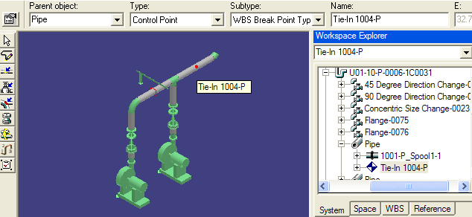
Make Drawable
Turns non drawable objects (like runs, support assemblies and control points drawable) allowing them to be labeled

Slide 52
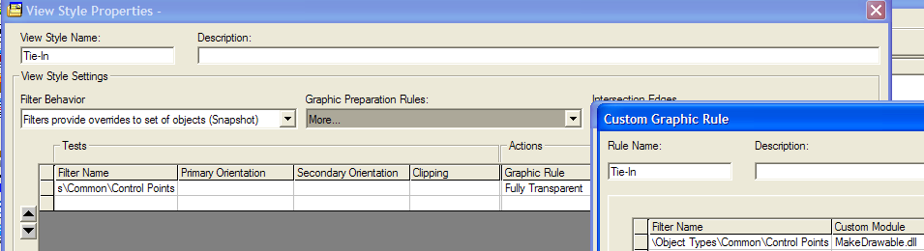
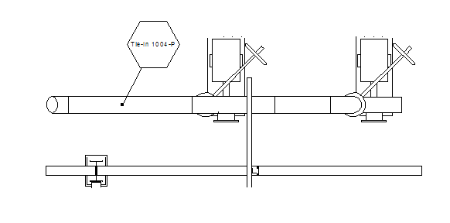
Make Drawable

Slide 53
Exclude
Excludes completely from the drawing objects specified – useful to throw out volumes or coordinate systems from drawings

Slide 54
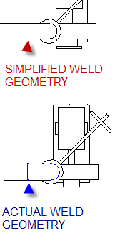
GetActual3DGeometry
Some geometry is simplified by SP3D (e.g. weld toruses to circles), this wrapper allows us to get original geometry if required

Slide 55
ReplaceWPoint
Replaces the 3D object with a point at its origin or center of range allowing it to be labeled without being drawn

Slide 56
Piping – for Single Line Drawings
CappedNormalPipe
ElbowToArc
ElbowToSingleArc
PipeTurnFeatToArc
SlopedPipeWArcSymbol
PortsSeparator

Slide 57
Equipment
EquipmentNozzleSeparator
DesignEquipmentPartSeparator
EnumerateEquipmentGraphicChildren

Slide 58
Hangers
ReplaceSlopedPipeonHgrs
EnumerateHgrSupGraphicChildren

Slide 59
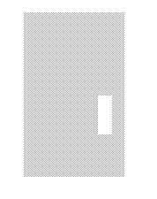
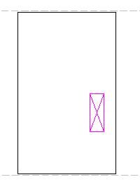
Structure
StructOpeningtoX
Resymbolizes Openings as X

Slide 60
Grids
GridLinesDrawingWrapperEntity
PlaneGeometryDrawingWrapperEntity

Slide 61
Lab 10, 11 and 12

Slide 62
Label Rules
Rules
Specify which labels are to be used in a view style
One rule may contain more than one label
Templates
Contain all detailed information about the label such as content, positioning, and leader

Slide 63
Positioning
Point generator
This is used to place label points on objects
Geometric analyzer
This is used to set properties on label points or delete label points in case they are collinear or occluded
Positioning module
This positions the label relative to the object

Slide 64
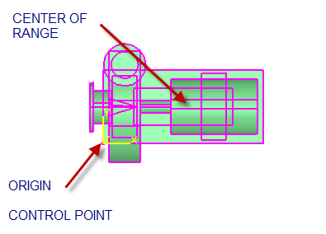
DefaultLabelPointGenerator DrawingPGControlPoint
Point is generated at the control point if there is one, then at the origin if there is one and finally at the center of the 2D range

Slide 65

DrawingPGLinear
Places label points at each end of straight features and members

Slide 66

DrawingPGLocalCS
Places a label point at the position of the local coordinate system

Slide 67
Label Settings
<labelOffset> | Label reach in meters from the terminator to the closest text box corner.
<granularity> | Attempted number of positions for text placement in clear space. 0 = Coarse - Reaches out at full text height increments within minimum and maximum offsets. 1 = Medium - Reaches out at one-half text height increments. 2 = Fine - Reaches out at one-third text height increments.
<perimeterOffset> | Defines the offset in meters from the clipped view edge when MarginOnly is used to place the label.
<priority> | Priority for labels relative to dimensions; setting = 1 for dimensions, 2 for labels. See note below.
<maxfactor> | Minimum and maximum scale factor in meters for the text size.
<minfactor>
<minOffset> | Minimum and maximum offset factor for clear space placement.
<maxOffset>

Slide 68

Label Offset
The labelOffset setting determines the reach from the terminator to the closest text box corner. This value is represented in meters. <labelOffset>0.04</labelOffset>

Slide 69

Granularity
Black = Coarse (0)
Red = Medium (1)
Green = Fine (2)

Slide 70

Perimeter Offset
The perimeterOffset option determines the offset that margin labels should be offset from the view border. The DrawingGAMarginOnly module must be used for the geometric analyzer. <perimeterOffset>0.055</perimeterOffset>

Slide 71
Label Layer Settings
<labellayer> | Determines in which layer the label is placed.

Slide 72

Leader Settings
Decides the kind of leader and its parameters

Slide 73


Positioning Settings
Position | Value
Top Left | 0
Top Middle | 1
Top Right | 2
Middle Left | 3
Middle Middle | 4
Middle Right | 5
Bottom Left | 6
Bottom Middle | 7
Bottom Right | 8
Control Point | 9

Slide 74
Lab 13

Slide 75
Special Labeling Techniques
Grid Labels for Elevation Views
Control Point Labels for Arbitrary Coordinates
Coordinate Labels

Slide 76
Lab 14, 15, 16 and 17

Slide 77
Dimension Rules
Rules
Specify which dimensions are to be used in a view style
Rules may contain anchoring rules
Templates
Contain all detailed information about the dimensions to be placed such as style, offset, units etc.

Slide 78
Positioning
Point generator
Geometric Analyzer
Content Module
Positioning module
Dimension Styles

Slide 79
Lab 18

Slide 80
Key Plan Style and Matchlines
Key Plan Type
Coordinate System
Range Filter
Orientation
View Style
Pseudo Filters

Slide 81



Key Plan Types

Slide 82

Key Plan Style
The Type selection filters the grid.
This shows a list of Coordinate Systems in the Model.
This is the range to display beyond the highlighted volume.

Slide 83
Key Plan
This is a delivered label. It centers the volume name.
This is a pseudo filter. There is another one called “KEY_PLAN_ADJACENT_ELEMENT”. It allows you to set the symbology for the surrounding volumes (if this were a Natural or Normalized type).

Slide 84


Range Filter – Grid Systems Orientation - Plan

Slide 85


Range Filter – Equipment and Members Orientation - Plan

Slide 86


Range Filter – Equipment and Members Orientation - Isometric

Slide 87
Drawings by Query
Where and what filters
Creating a package
Navigation Rules
Embedded Reports

Slide 88


Drawings by Query
ADMINISTRATIVE SETUP
BY QUERY MANAGER
What do you want to document?
Where do you want to look?
Template
Filter
that answers
the “Where” question.
Drawing Package
Filter
Defining “What”
Drawing Package

Slide 89
Drawings by Query - Example

Slide 90
Drawings by Query - Example

Slide 91

Navigation Rules
Navigation Rule defines content of drawing based on hierarchy or relationships of target object
Ensures that only objects which are related to target object appear in drawing and associated report

Slide 92



No navigation rule
Parts from other spool appear in drawing

Slide 93


With navigation rule
Parts from other spool excluded

Slide 94
Lab 19

Slide 95
Batch Processing
Setup
Operation/Monitoring

Slide 96
Special Topics
WBS based view styles
MicroStation DGN Output View Style
Search Folders

Slide 97
Lab 20, 21 and 22

Slide 98
Troubleshooting
Error logs
Flush Threshold
VHL Precision
Geometry Validation
Tips for out of memory issues

